Slide 1
CENG-232 Logic Design
Lecture 1
Introduction, Digital Logic & Circuits

Slide 2


Which one?

Slide 3


Which one?

Slide 4
This class is about “Digital Systems”
They are everywhere
They make life easier, more enjoyable
The most famous digital system is
A general purpose computer
It has a memory unit, central processing unit and input/output units
Programmable: same device, many different purposes
At the end of this class, you will be able to
Design and implement digital systems at various levels of abstraction
Why?
To make others’ lives easier and more enjoyable some day..
232 - Logic Design
Page 4

Slide 5
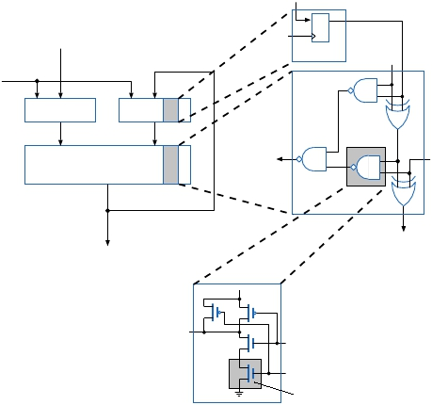
This class is about
Electronics (Transistors)
Digital Circuits
Combinational (Gates)
Sequential (Adder, etc.)
Timing
Signals, Speed, Delay
Physical vs. Logical
Parallelism
Notes:
Not a course on transistor physics and transistor circuits. Although, we will look at these to better understand the primitive elements for digital circuits.

Slide 6
Introduction
What is a digital system?
How it differs from an analog system?
Why are digital systems important?
Basic types of digital systems: combinational and sequential
Specification and implementation of digital systems
Analysis and design of digital systems
Design process and CAD tools
232 - Logic Design
Page 6

Slide 7
What is Digital?
Digital Systems
inputs and outputs come from a set of finite number of discrete values
Analog Systems
inputs and outputs come from a continuous (infinite) set
Example: digital vs. analog scale for measuring weights
Main uses of digital systems:
Information processing
Transmission (communication)
Storage
Many forms of "information"
232 - Logic Design
Page 7

Slide 8
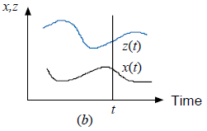
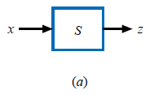
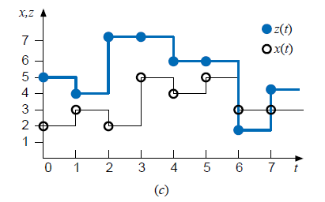
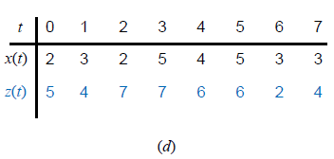
Signals and Systems
232 - Logic Design
Page 8

Slide 9
Why are Digital Systems important?
1) Well suited for both numerical and nonnumerical information processing
2) We can use a general-purpose system for information processing
a computer
eliminate the need for having a different system for each task
3) Digital representation:
Finite number of values in the digital signal can be represented by a vector of signals with just two values (binary signals)
When all signals are binary we can have simple devices to process binary signals:
just switches with two states: open and closed
232 - Logic Design
Page 9

Slide 10
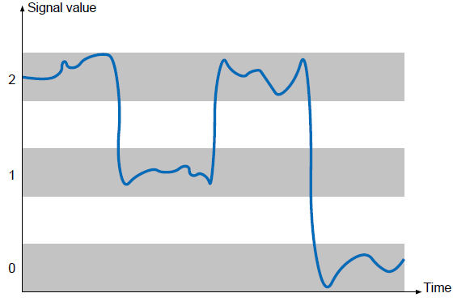
Why Digital?
4) Digital signals quite insensitive to variations of component parameter values
232 - Logic Design
Page 10

Slide 11
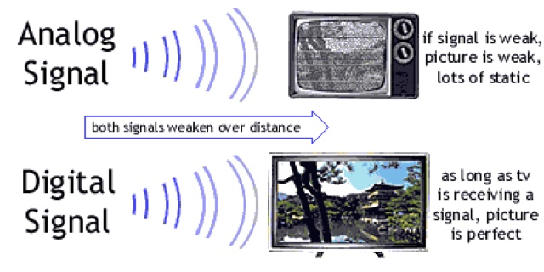

Slide 12
Why Digital?
5) Numerical digital systems can be made more accurate by simply increasing the number of digits used in the representation.
720p vs 1080p
12:30 vs 12:30:47
6) Phenomenal advances of microelectronics technology:
Possible to fabricate (with low cost) extremely complex digital systems that are small, fast and cheap
Digital systems built as integrated circuits (IC) composed of a large number of very simple devices
232 - Logic Design
Page 12

Slide 13
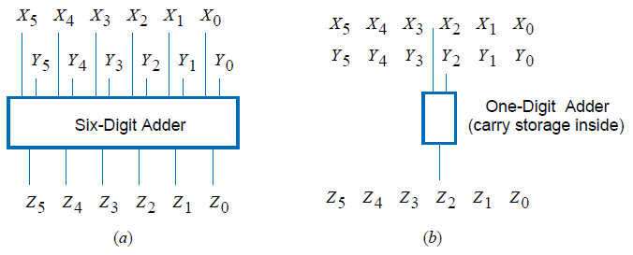
Why Digital?
7) Different implementations of systems which trade-off speed and amount of hardware
Example:
add two integers represented by six decimal digits
232 - Logic Design
Page 13

Slide 14
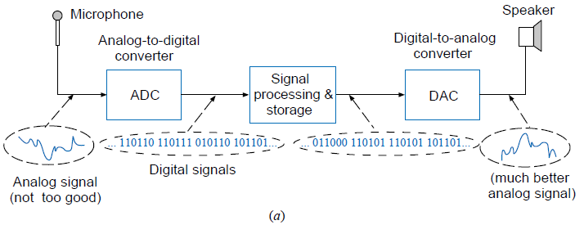
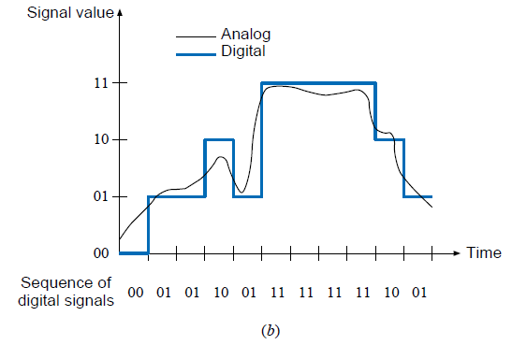
Mixed Analog/Digital Systems
232 - Logic Design
Page 14
Notes:
There are limits to digital techniques:
The analog nature of the world requires a time consuming conversion process:
Convert the physical variable to an electrical signal (analog).
Convert the analog signal to digital form.
Process (operate on) the digital information.
Convert the digital output back to real-world analog form.

Slide 15
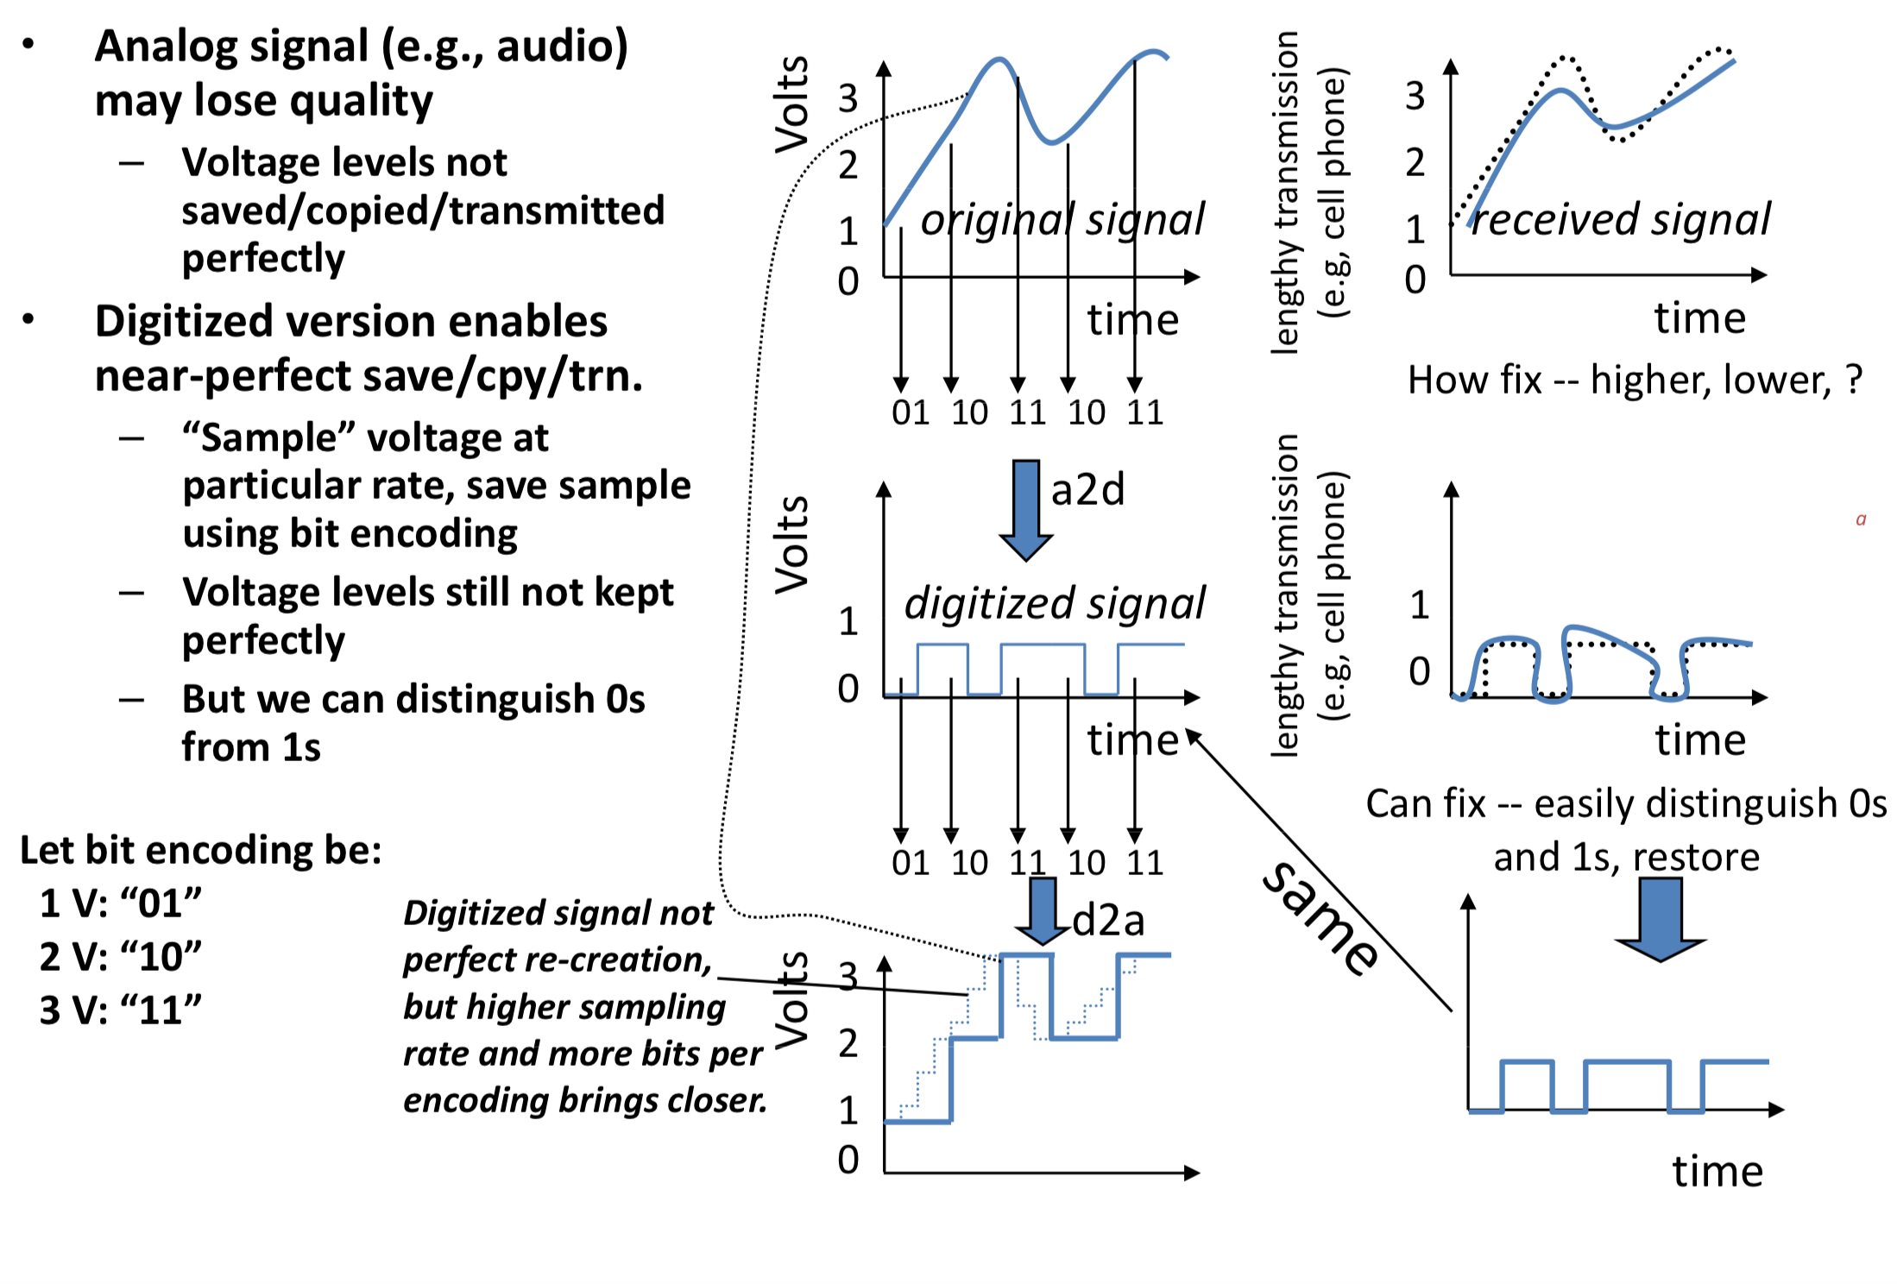
Example of Digitization Benefit

Slide 16
Ways of digitization
How can we represent binary information?
CPU
Hard Disk
CDs

Slide 17
Combinational and sequential systems
Digital systems - two classes:
Combinational systems
z(t) = F(x(t))
no memory, the output does not depend on previous inputs
Sequential systems
z(t) = F(x(0; t))
x(0; t): input sequence from time 0 to time t
z(t) depends also on previous inputs - the system has memory
232 - Logic Design
Page 17

Slide 18
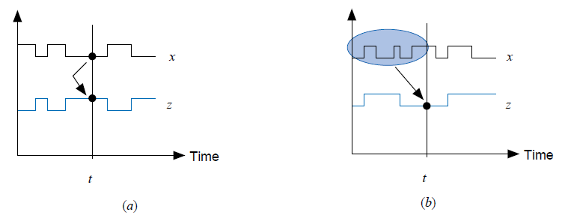
Combinational and sequential systems
232 - Logic Design
Page 18

Slide 19
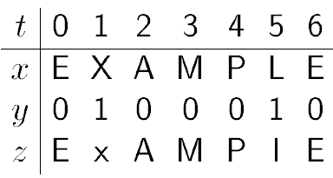
Example: Combinational System
Input x(t) with values from the set of letters (upper and lower case)
Input y(t) with values 0 and 1
The function:
change x(t) to opposite case when y(t) = 1
leave it unchanged when y(t) = 0
An input-output pair:
232 - Logic Design
Page 19

Slide 20
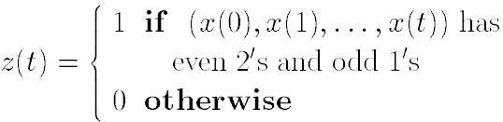
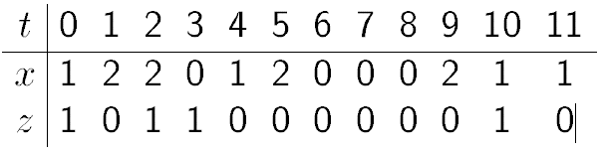
Example: Sequential System
Input x with values 0,1, or 2
Output z with values 0 or 1
An input-output pair:
232 - Logic Design
Page 20

Slide 21
Logic Example
Truth Table
Representation
HI
0
0
1
1
LO
0
1
0
1
Pump
0
1
0
x
Drain
0
0
1
x
Tank level is OK
Low level, pump more in
High level, drain some out
Inputs cannot occur
HI
Pump
Schematic
Representation
Drain
LO
Notes:
A circuit controlling the level of fluid in a tank
inputs are:
HI - 1 if fluid level is too high, 0 otherwise
LO - 1 if fluid level is too low, 0 otherwise
outputs are:
Pump - 1 to pump fluid into tank, 0 for pump off
Drain - 1 to open tank drain, 0 for drain closed
input to output relationship is described by a truth table

Slide 22
Timing Diagrams
X
Y
Z
X
Y
Z
Timing Diagram for X and Y (input), Z (output)
Actually, there is a delay at each new rising/falling pulse, but not shown here! (will be discussed later)
Notes:
Timing diagrams show how inputs and outputs for a logic circuit change in time
For given input timing diagrams, we can draw the output timing diagrams for a given combinational circuit.
Consider the following XOR circuit with 2 inputs:

Slide 23
Analysis / Design
Specification
(function and other
characteristics)
WHAT
Analysis
Design
Implementation
(network of modules)
HOW
Notes:
The study of any system involves its specification and implementation.
The specifications refers to a description of its function and of other characteristics required for its use, such as speed technology and power consumption.
Specification is related to what the system does without reference to how it performs the operation.
A specification is should be as complete as possible, all required details should be there and nothing more.
It should be formal in the sense that its interpretation is unambigious.

Slide 24
Specification and Implementation
The specification of a system describes its function.
Objective:
to use the system as a component in more complex systems; and
to serve as the basis for the implementation of the system by a network of simpler components.
232 - Logic Design
Page 24

Slide 25
Specification
Can be done at different levels
high-level
binary-level
algorithmic-level
For different types of systems:
Spec. of combinational systems: Chapter 4
Spec. of sequential systems: Chapter 5
Spec. of algorithmic systems: Chapter 6, 8
232 - Logic Design
Page 25

Slide 26
Implementation
How the system is constructed from simpler components
In digital systems, implementation is
a digital network consists of the interconnection of modules
Several levels depending on the complexity of the primitive modules
from very simple gates to complex processors
Physical level: interconnection of electronic elements
Transistors, resistors
Different methods for different types
Combinational systems: At gate and module levels
Sequential systems
Algorithmic systems
Hierarchical implementation
232 - Logic Design
Page 26

Slide 27
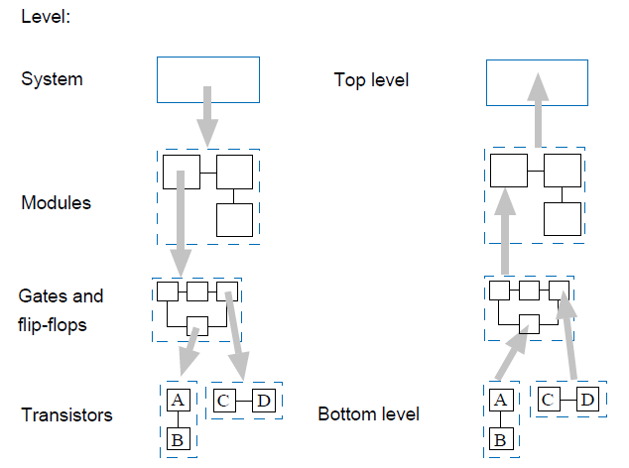
Implementation Levels
232 - Logic Design
Page 27
Notes:
❑ There are two basic approaches to system design
◦ Top-Down: start at the top system level and decompose into ever simpler subsystems and components
◦ Bottoms-Up: start with known low-level building blocks and put them together into increasing complex functions
❑ Ideally either should work; however, in practice neither method does
Helps control complexity -
by hiding details and reducing the total number of things to handle at any time.
Modulalizes the design -
divide and conquer
simplifies implementation and debugging
Top-Down Design
Starts at the top (root) and works down by successive refinement.
Bottom-up Design
Starts at the leaves & puts pieces together to build up the design.
Which is better?
In practice both are needed & used.
Need top-down divide and conquer to handle the complexity.
Need bottom-up because in a well designed system, the structure is influence by what primitves are available.

Slide 28
Analysis / Design
Specification
(function and other
characteristics)
Analysis
Design
get specification from an implementation
obtain an implementation that satisfies the specification
Implementation
(network of modules)

Slide 29
Structured Analysis and Design
Analysis:
get specification from an implementation
Design:
obtain an implementation that satisfies the specification
Use of multilevel approach necessary
The top-down and bottom-up approaches
There exists no systematic procedures to achieve the optimal
A combination of the two approaches
232 - Logic Design
Page 29

Slide 30
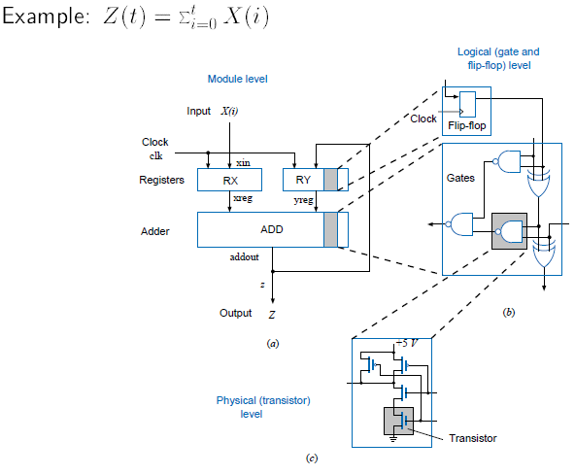
Levels: module, logical, physical
232 - Logic Design
Page 30

Slide 31
Computer-Aided Design Tools
Design of digital systems an involved and laborious process
Various computer-aided design (CAD) tools available
Main types of CAD tools support the main phases of digital design:
description (specification),
design (synthesis) including various optimizations to reduce cost and improve performance, and
checking of the design with respect to its specification.
The design phases typically require several passes
232 - Logic Design
Page 31

Slide 32
CAD
Description of digital systems for design purposes
At a high-level, use hardware-description language (HDL)
At the binary level, use HDLs to describe the system structure
Editors used to produce HDL programs
Graphical forms - logic diagrams also used for structure
232 - Logic Design
Page 32

Slide 33
uVHDL Description
USE WORK.ALL;
ENTITY sample_system IS
PORT (xin: IN BIT_VECTOR;
z : OUT BIT_VECTOR;
clk: IN BIT );
END sample_system;
ARCHITECTURE structural OF sample_system IS
SIGNAL xreg, yreg, addout: BIT_VECTOR(7 DOWNTO 0);
BEGIN
RX: ENTITY BitReg8 PORT MAP(xin,xreg,clk);
RY: ENTITY BitReg8 PORT MAP(addout,yreg,clk);
ADD: ENTITY Adder PORT MAP(xreg,yreg,addout);
z <= addout;
END structural;
232 - Logic Design
Page 33

Slide 34
CAD
Synthesis and optimization tools
Semi-automated
Simulation tools generate behavior of a system for given input
Logic simulation
Timing simulation
232 - Logic Design
Page 34

Slide 35
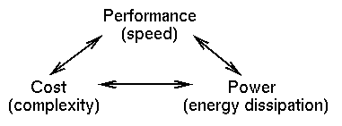
Design Trade-offs
You can improve on one at the expense of worsening one or both of the others.
These tradeoffs exist at every level in the system design - every sub-piece and component.
Design Specification -
Functional Description.
Performance, cost, power constraints.
As a designer you must make the tradeoffs necessary to achieve the function within the constraints.

Slide 36
Examples
Computer
Designed to maximize performance.
"Optimized for speed”
Handheld calculator
Usually designed to minimize cost.
“Optimized for low cost”
Of course, low cost comes at the expense of speed
Digital watch
Designed to minimize power. Single battery must last for years.
Low power operation comes at the expense of:
lower speed
higher cost

Slide 37
Assignment
Read Chapter 1
Optional: Read Appendix A of the book

Slide 38
Quiz
You already know one of the most complex digital systems
What is the simplest digital communication system ever built?

Slide 39
Transistors
https://www.youtube.com/watch?v=MVAqfj9RTPA

